Slide 1
Review these slides to study
If you want to make a change to these slides, you must make your own copy then you can edit them on your own account

Slide 2
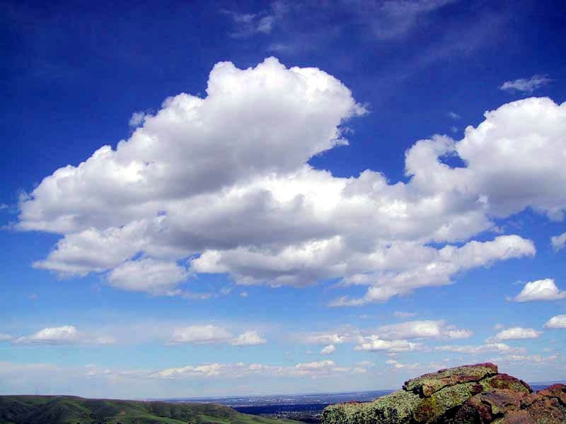
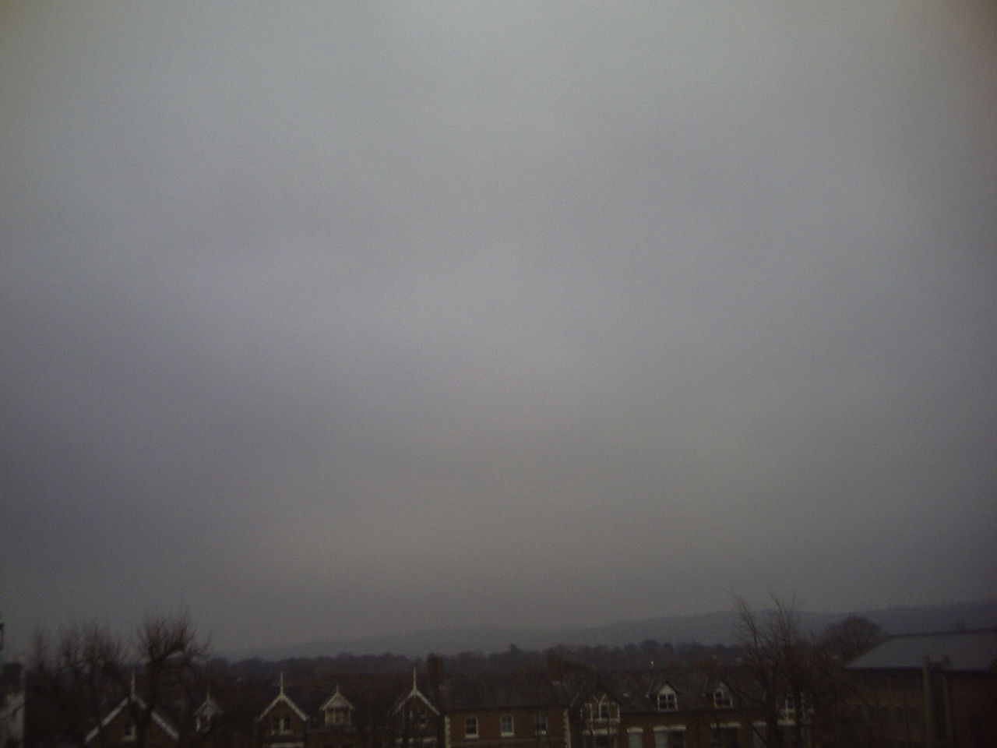
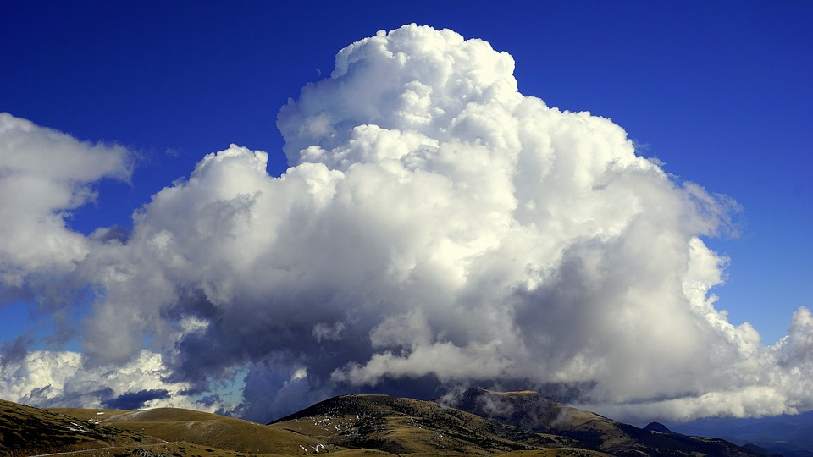
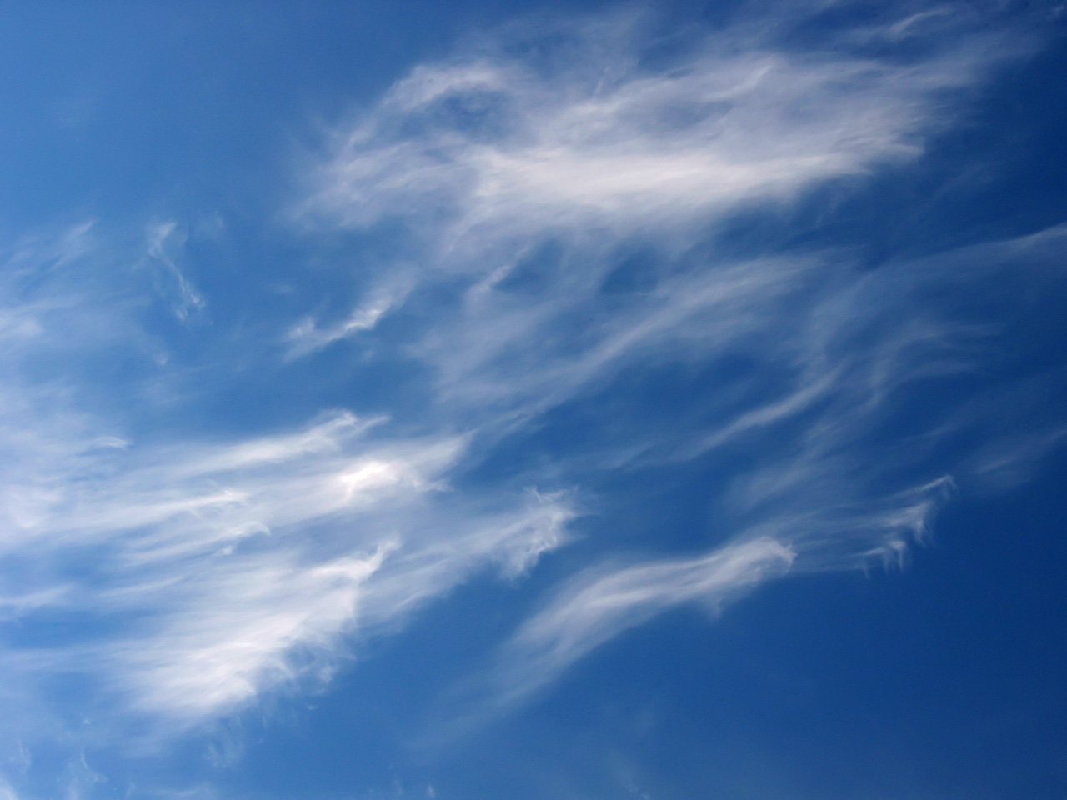
Clouds
Cumulus Clouds are for fair weather- Temperature doesn’t matter because these clouds can show up at all times of the year. Cumulus Clouds show up when there is high Pressure- High Pressure equal high high happy weather
Stratus clouds are low and gray and cover a lot of the sky. They signal drizzly rainy weather- They occur when it is low pressure
Cumulonimbus Clouds are a tall tower of clouds that indicate Bad Weather and that storms are approaching- anything in Nimbus looks for stormy or bad weather
Cirrus Clouds are high level clouds- They are thin and wispy, a Warm front might be coming through

Slide 3
Low Pressure and High Pressure do not indicate temperatures- they can occur any time of the year.
High Pressure means- High High- Happy Happy- Happy Weather- Fair Weather High Pressure means all the air is pushed down towards the Earth and there is no moisture up in the cloud area to make bad Weather.
Low Pressure- Low-Bad Weather- Rainy Clouds- All the air is taken up to the clouds and it carries moisture and rain with it
HIGH PRESSURE ALWAYS MOVES TO LOW PRESSURE IF YOU ARE GIVEN A WEATHER MAP

Slide 4
HOW HEAT ENERGY IS TRANSFERED
CONDUCTION
Heat energy is transfered by touching.
Ex. pan on a stove, metal touching or conducting energy-
CONVECTION
Hot goes up and cold comes down- this works in the air and in water
RADIATION
The sun radiates Heat- Radiant Heat moves in all directions- heats things evenly.
Ex. campfire, sun, lightbulbs
Don’t forget- Metal, copper especially are good conductors(heat is transfered or moved really well)
Styrofoam, rubber, plastic, wood these are poor conductors- they stop Heat from traveling
Warmer objects give heat to the cooler objects.

Slide 5
Global and Local Winds
Prevailing Westerlies Move from West to East across the US- bringing Weather with them
Jet Streams are a current of Air traveling above the US moving West to East- The Jet Stream can bend south bringing cold air with it, or it can bend North bringing Warm air with it.
Trade Winds are South of the US- probably not the correct answer- unless it is about EL Nino- which brings stormy Wet weather to the West Coast and Mexico
Land Breezes- occur at night time or when the land is colder than the Ocean
Sea Breezes- occur during the daytime when the land is hotter than the Ocean
Breezes and Winds occur because of the Uneven heating of the Earth(convection)
COLD FRONTS- COME IN ANGRY AND CAUSE STORMS
WARM FRONTS COME IN GENTLY & CAUSE WARMER AND POSSIBLY RAINY WEATHER TO COME

Slide 6
Water Cycle- the Sun Drives the Water Cycle
Evaporation- Goes up, water turns into a gas- water vapor as it is heated up- water from a puddle is evaporated. The larger the surface that is exposed to the sun the more water will be evaporated
Transpiration- When Water is Evaporated out of the leaves of a plant
Condensation- When the upper atmosphere Cools the vapor/gas turns back into water in the Clouds
Evaporation and Condensation occur when Heat Energy is changed
Precipitation- always comes down to the Earth- the clouds can’t hold the moisture anymore so it rains, snow, hails or sleets- Hail is when the precipitation bounces up and down and gets layers- sleet is when it is not quite frozen yet
Run-off is when the ground can not absorb the water so the water runs off somewhere else
Remember there is ground water running under our ground that carries rivers of water to rivers and the Ocean

Slide 7
How the Earth affects Weather
The Earth is tilted on its Axis- Which Causes the Sun to Heat the Earth in different ways
The tilt causes Seasons around the World- the Northern and Southern Hemisphere have different Seasons
The Equator gets direct Heat so it is hotter closer to the Equator
Places further away from the Equator get indirect Heat so they are not as Warm
When the Earth is rotated away from the Sun it is Night, When it is rotated towards the Sun it is Day
It is takes 365 ¼ days to revolve around the Sun, It takes 24 hours for the Earth to Rotate
Weather changes day to day- Wind Speed(anemometer), precipitation(rain guage) temperature(thermometer) and air pressure(barometer) Climate are weather patterns over a long period of time)

Slide 8
Gulf Stream and Hurricanes
The Gulf Stream is a warm river of water in the Ocean that Comes from near the Equator up our coast by Florida.
It brings warm water up our coast which warms the air and warms our coast, IT MAKES THE WEATHER NEAR THE COAST NOT AS HOT AND NOT AS COLD- MORE MODERATE TEMPERATURE
Hurricanes form over the Water and come most often during the months that the Ocean is the warmest- August through October- Because lots of the Ocean is evaporated into the Air to create lots of Moisture to give the Hurricanes.

Slide 9
Biomes- Aquatic(water)
Oceans- Most varied amount of Biotic Life(any living organism)- Oceans take up over 75% of the Earth-- Saltwater- Plankton is a producer
Rivers/Lakes/Ponds- Freshwater- Standing Water- Lakes and Ponds- need algae(single celled organism that provides a lot of the Oxygen for us in the world)- rivers/moving water grab oxygen from the air as it moves so it doesn’t have as much algae
Estuaries/Salt Marshes- a mix of fresh and saltwater- it is where the rivers dump into the Oceans- a lot of young organisms live there to mature.

Slide 10
Biomes- Terrestrial(any form of this word means land)
Deciduous Forest- Tall Trees that do not lose their leaves- get more rain then grasslands
Rainforest- A large amount of organisms- Different Layers- Very Wet and Moist- Near the Equator
Grasslands- Mostly grasses and organisms that don’t need as much water. They have fertile soil. They get a medium amount of rain

Slide 11
Food Chains- The sun’s energy drives all biotic and abiotic(not living) cycles on Earth.
Producers-
An organism that makes it own Energy
Ex. Plants, algae
-They are first in the Food Chain after the Sun
Consumers-
Organisms that have to Eat something else to get their Energy
Ex. Animals, us, fish, bears
Primary Consumer- Animals that Eat Plants
Secondary Consumers- Animals that eat other Animals
Tertiary Consumers- the 3rd consumer in the line of the Food Chain
Decomposers
Last in the Food Chain- They break down and Eat Dead Organisms to recycle their energy back into the Environment
Ex. mushrooms(FUNGI), Earthworms, Bacteria, snails,
If you take out one thing in an Ecosystem- everything else will be affected
Think about pollution and human effects

Slide 12
Inherited and Learned Traits
We inherit traits(characteristics from our parents or grandparents)- sometimes these traits skip generations.
Inherited traits- Traits that we have when we are born- because they are passed down in our genes or DNA
Ex. Eye Color, Hair Color, cleft chin, rolling our tongue
Learned Traits- traits that we learn after we are born
Ex. language that we speak, love of music, how to play baseball

Slide 13
Single Celled vs Multi-celled Organisms
Single Celled Organisms- are made up of just one cell and they perform all the life functions necessary to survive
Ex. amoeba, algae, paramecium- So small that you need a microscope to see
Multi-Celled Organisms- organisms that are made up of many cells(have tissues, organs and systems)- They have SPECIALIZED cells that are required or survival.
CELLS WITHIN AN ORGANISM ARE SO FAR AWAY FROM THE ENVIRONMENT THAT THEY NEED TRANSPORT SYSTEMS
Ex. humans, Hydra, plants,

Slide 14
Cardiovascular/Circulatory System
Respiratory System
HEART - BLOOD
Veins- Carries Blood TO the heart
Arteries- Carries Blood AWAY from the Heart
Capillaries- Where the exchange of oxygen, waste, nutrients and Carbon Dioxide occurs, at the ends of the veins and arteries
It pumps blood around the body to carry the gases around the body- Think of the Blood mobile- Red Blood Cells- carries stuff
White Blood Cells- Fights infections
Includes the Nose, Lungs, Diaphragm & Trachea
Brings in Oxygen and Breathes out Carbon Dioxide
Works closely with the Circulatory System
The Blood is pumped into the lungs to pick up and drop off the Oxygen and Carbon Dioxide

Slide 15
Muscular System Skeletal System
Smooth Muscles- Muscles inside the Organs
Cardiac Muscle- The muscle of the Heart
Skeletal Muscle- Attaches to the skeletal- helps the bones to move
Protects our organs
Gives us Support
Helps us with Movement
Produces Blood Cells- Think of the red jelly in the bone model
Stores Nutrients- think of the milk in your bones to keep you strong

Slide 16
Nervous System Digestive System
Brain- Control Center for the Entire Body- it tells all the other systems to work
Spinal Cord and Nerves- Carries messages around the body
Esophogus
Stomach- mixes up and breaks down the food
Bile- a Chemical that breaks down the food even more
Small Intestine- Absorps the nutrients out of the food
Large Intestine- Takes the water out of the food

Slide 17
Friction and Mass Affecting Motion
Friction slows down the movement of Object
Friction occurs when things are bumpier or have more texture
Mass in objects make it require more force to START or STOP the movement of objects.

Slide 18
GRAVITY and Potential and Kinetic Energy
Gravity pulls objects towards the Earth.
All objects no matter the mass fall at the same rate, unless Air Resistance gets in the way
Potential Energy- stored Energy- Objects at a Higher Position or objects with more Mass have more potential Energy
Kinetic Energy is energy in motion

Slide 19
Chemical and Physical Change
Physical Change is the change in size, shape or state of matter
Objects that break, melt, freeze or evaporate show physical changes,
Ex. water boiling, salt and water mixing, glass breaking
Chemical Changes
Changes that change the molecules inside the object- something new is created- it can’t go back
Signs a chemical change occured
Heat or light is produced
Gas is formed
Temperature changed
Color Changed
Ex. any being burnt, baking a cake, baking soda and vinegar mixing, milk spoiling

Slide 20
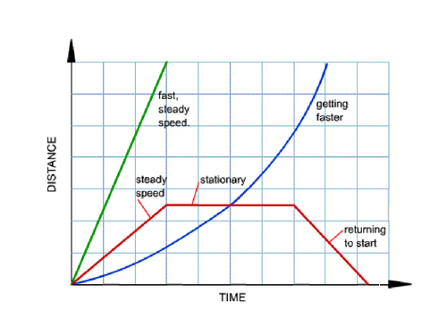
Graphs and Motion
You can measure motion of an object based on the distance it travels in a certain amount of time.
Do speed equals distance divided by time.
Be prepared to do a math problem on the EOG
Distance / time
Do not forget to highlight and really pay attention to the time word on the x axis and the distance word on the y axis

Slide 21
The Weight of an object is the sum of its parts
If you have 10 grams of liquid and you add 3 grams of salt and 3 grams of fruit powder. Just add the totals to get 16.
Be ready for a problem on the EOG where you have to add up the numbers to get the total. It is not a trick question, it is just that obvious.

